Slide 1
Introduction to IN711 - Algorithms and Data Structures
Lecturer: David Rozado

Slide 2
Motivation for this course
The biggest differences between fresh BIT and computer science graduates from University are the following:
BIT students probably have more applied knowledge and know-how using modern tools
University CS students probably have more understanding of computational theory
In particular, CS students have been exposed to several theoretical subfields within mathematics that play key roles in computer science and particularly in the study and development of algorithms
Differential calculus
Symbolic and numerical integration
Discrete mathematics
Linear algebra
Probability theory
Statistics
Complexity theory
As IT graduates, you will compete with computer science graduates for jobs, promotions, funding, etc.
You will also work alongside with them in organizational projects
This paper will partially try to address the most critical theoretical gap that exist between BIT and CS students so you can work and communicate effectively with CS graduates

Slide 3
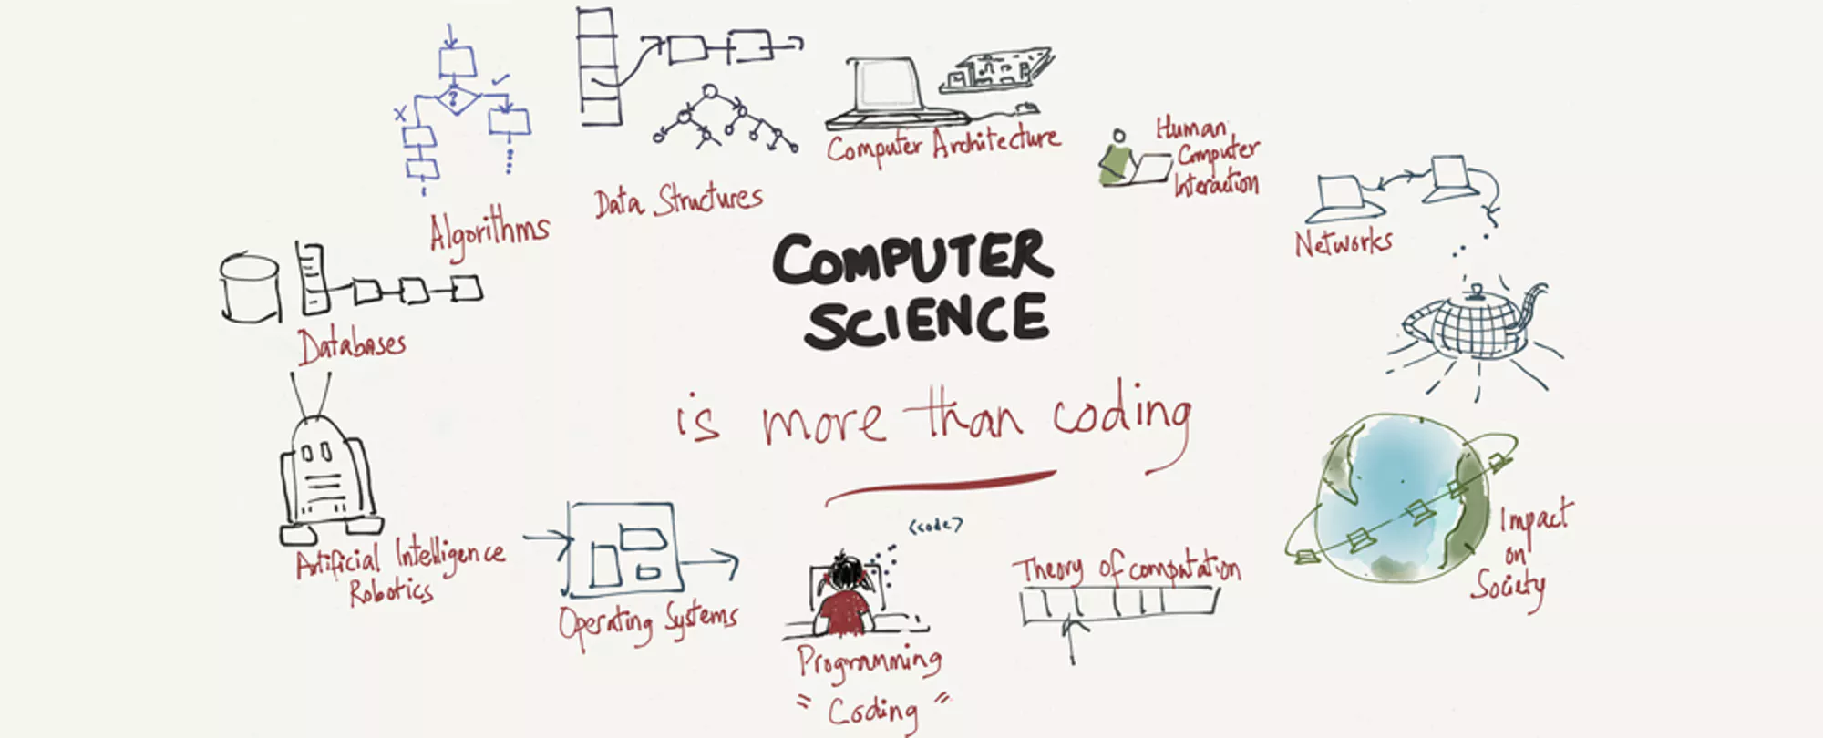
Computer Science
Computer science is more than simply programming computers
Although computers play an important supporting role as a tool in the discipline, they are just that–tools
An important subfield of Computer science is the study of computational problems, problem-solving, and the solutions that come out of the problem-solving process.
And that is the field of algorithms and data structures
Sophisticated Algorithms rely heavily on several branches of mathematics

Slide 4
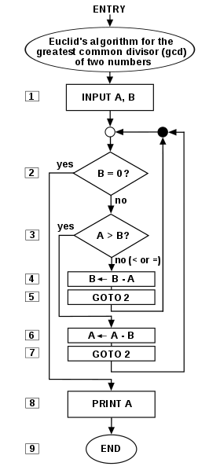
Computable problems and algorithms
Algorithms are finite processes that if followed will solve a computational problem
Informally, and algorithm is any well-defined computational procedure that takes some value, or set of values, as input and produces some value, or set of values, as output
An algorithm is thus a sequence of computational steps that transforms the input into the output
Given a computational problem, a computer scientist’s goal is to develop an algorithm, a step-by-step list of instructions for solving any instance of a problem
We must be cognizant that some problems may not have a solution.
Computational theory is the study of solutions to problems as well as the study of problems with no solutions.
We say that a problem is computable if an algorithm exists for solving it.
In a finite amount of time using finite resources
Note that the word “computer” did not come up at all.
Solutions are considered independent from the machine.
Flowchart of an algorithm (Euclid's algorithm) for calculating the greatest common divisor (g.c.d.) of two numbers a and b in locations named A and B.

Slide 5
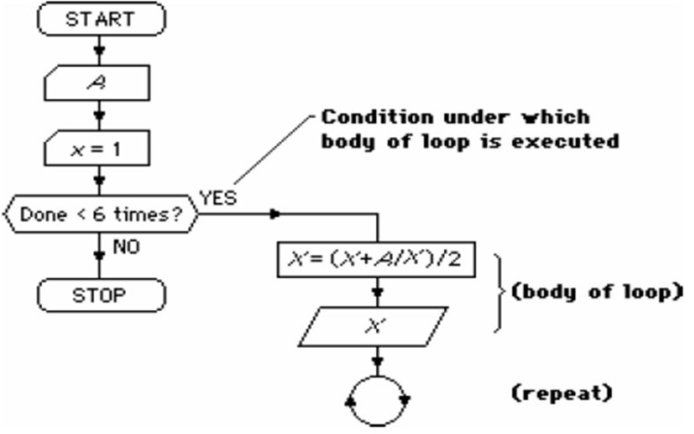
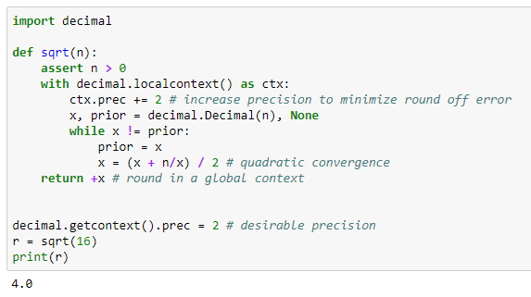
Relationship of algorithms to programming
Programming is the process of taking an algorithm and encoding it into a notation, a programming language, so that it can be executed by a computer.
Although many programming languages and many different types of computers exist, the important first step is the need to have the solution.
Without an algorithm there can be no program.
Programming is often the way that we create a representation for our solutions.

Slide 6
Control constructs and datatypes
Algorithms describe the solution to a problem in terms of the data needed to represent the problem instance and the set of steps necessary to produce the intended result
Programming languages must provide a notational way to represent both the process and the data
To this end, languages provide
Data types
Control constructs

Slide 7
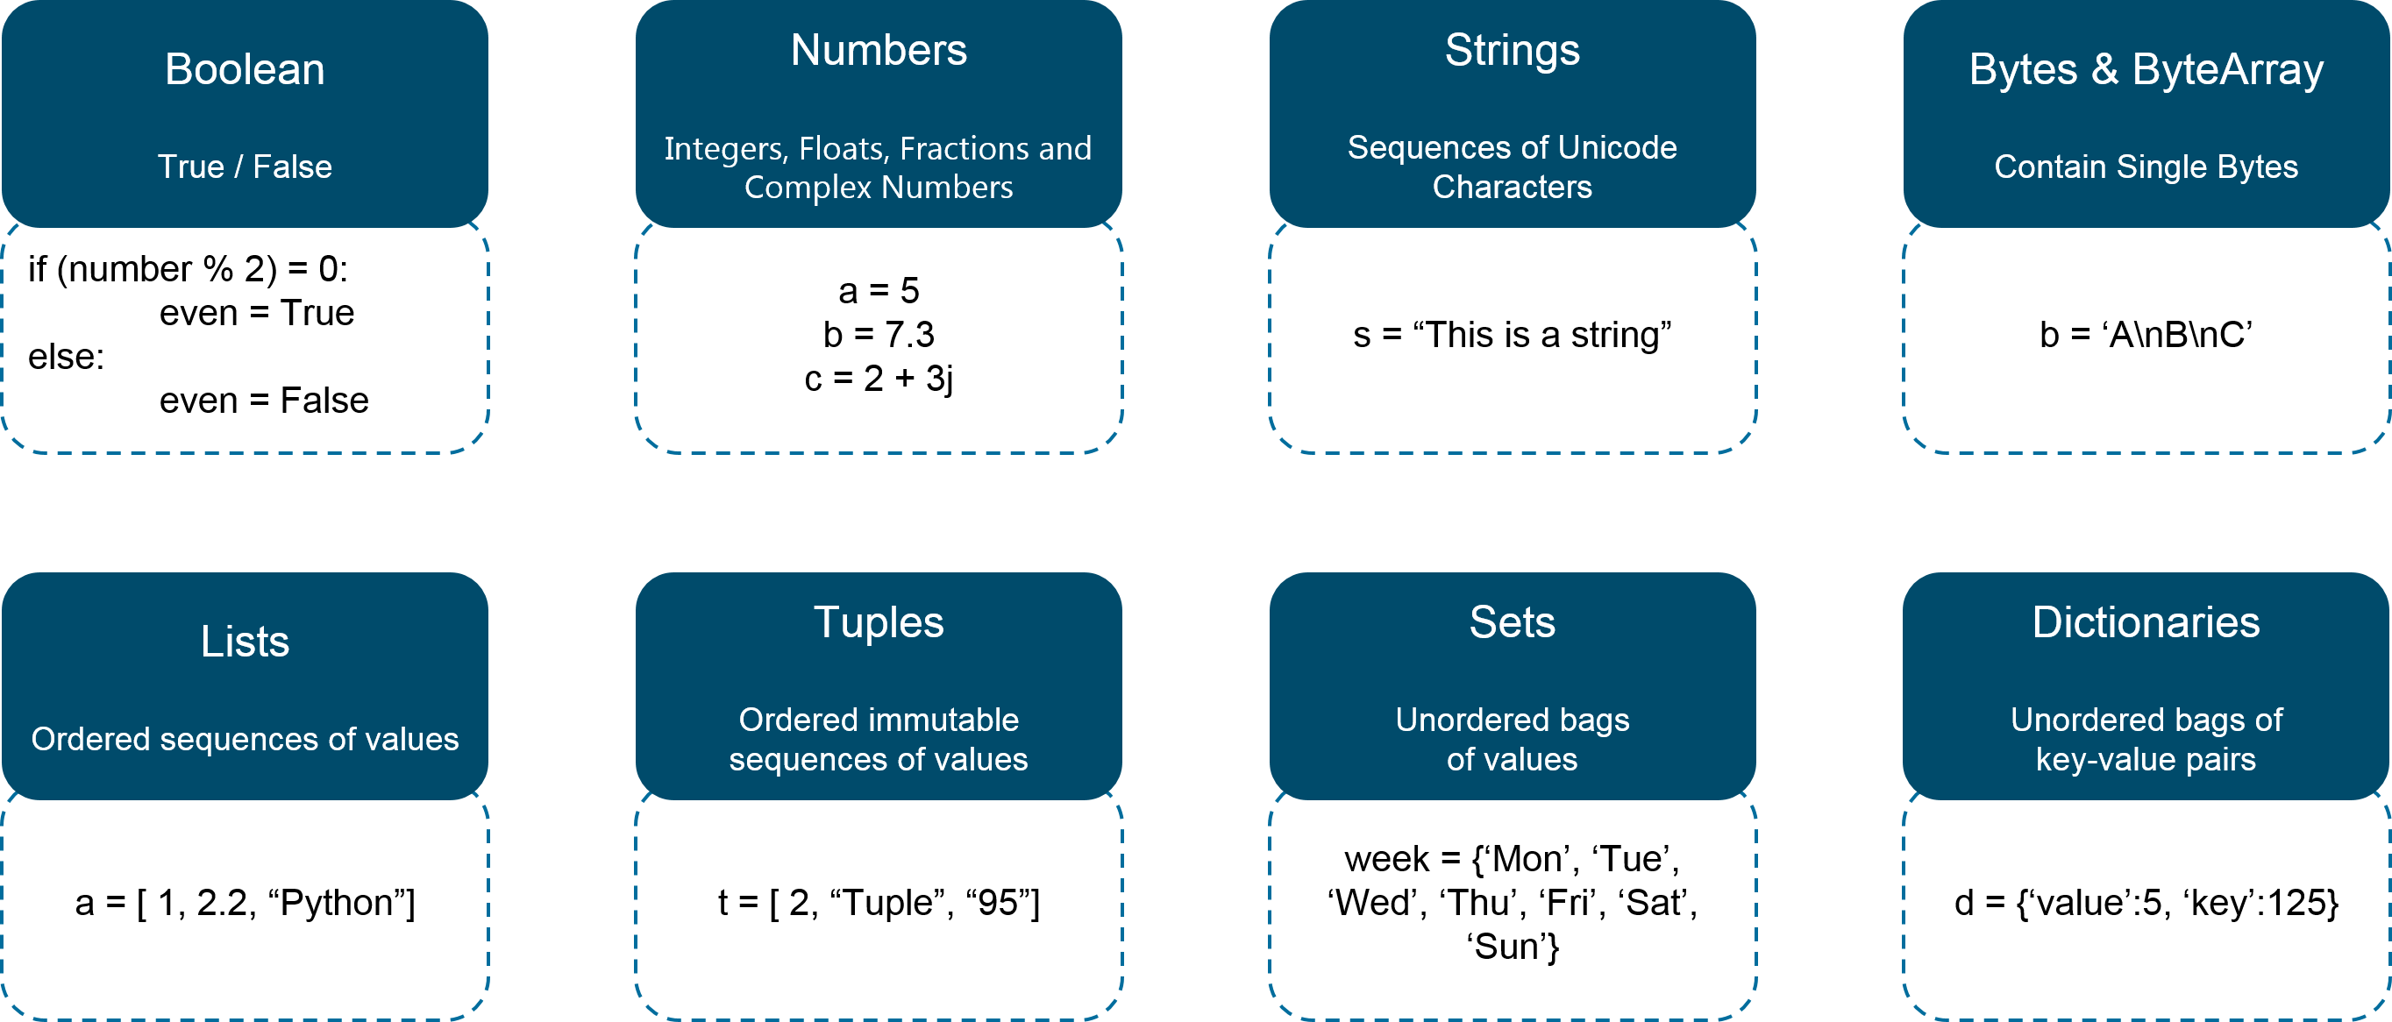
Data types
All data items in the computer are represented as strings of binary digits.
In order to give these strings meaning, we need to have data types.
Data types provide an interpretation for this binary data so that we can think about the data in terms that make sense with respect to the problem being solved.
These low-level, built-in data types (sometimes called the primitive data types) provide the building blocks for algorithm development.
Using primitive data types as building blocks, derived datatypes can be implemented
For example, most programming languages provide a data type for integers. Strings of binary digits in the computer’s memory can be interpreted as integers and given the typical meanings that we commonly associate with integers (e.g. 23, 654, and -19).
A data type also provides a description of the operations that the data items can participate in.
With integers, operations such as addition, subtraction, and multiplication are common.

Slide 8
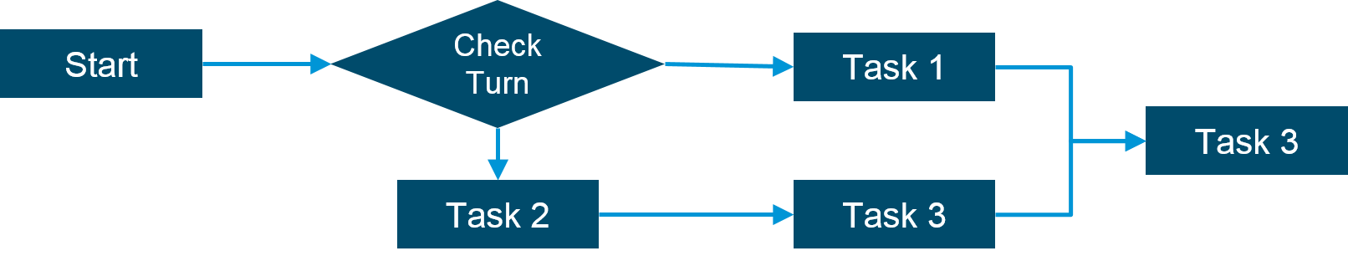
Control constructs
Control constructs allow algorithmic steps to be represented in a convenient yet unambiguous way
At a minimum, algorithms require constructs that perform sequential processing, selection for decision-making, and iteration for repetitive control
As long as the language provides these basic statements, it can be used for algorithm representation.

Slide 9
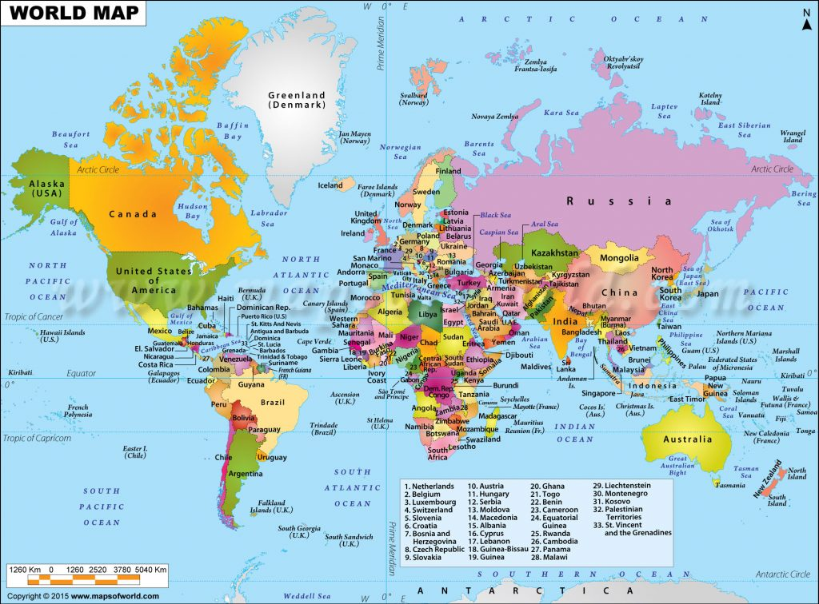

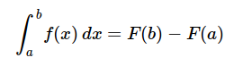
Abstraction
Abstraction
Abstraction could be loosely defined as making a problem easier to understand by ignoring the unimportant details
Abstraction allows us to view the problem and solution in such a way as to separate the so-called logical and physical perspectives
Examples of abstractions:
Hierarchy of Abstraction
Concrete details

Slide 10
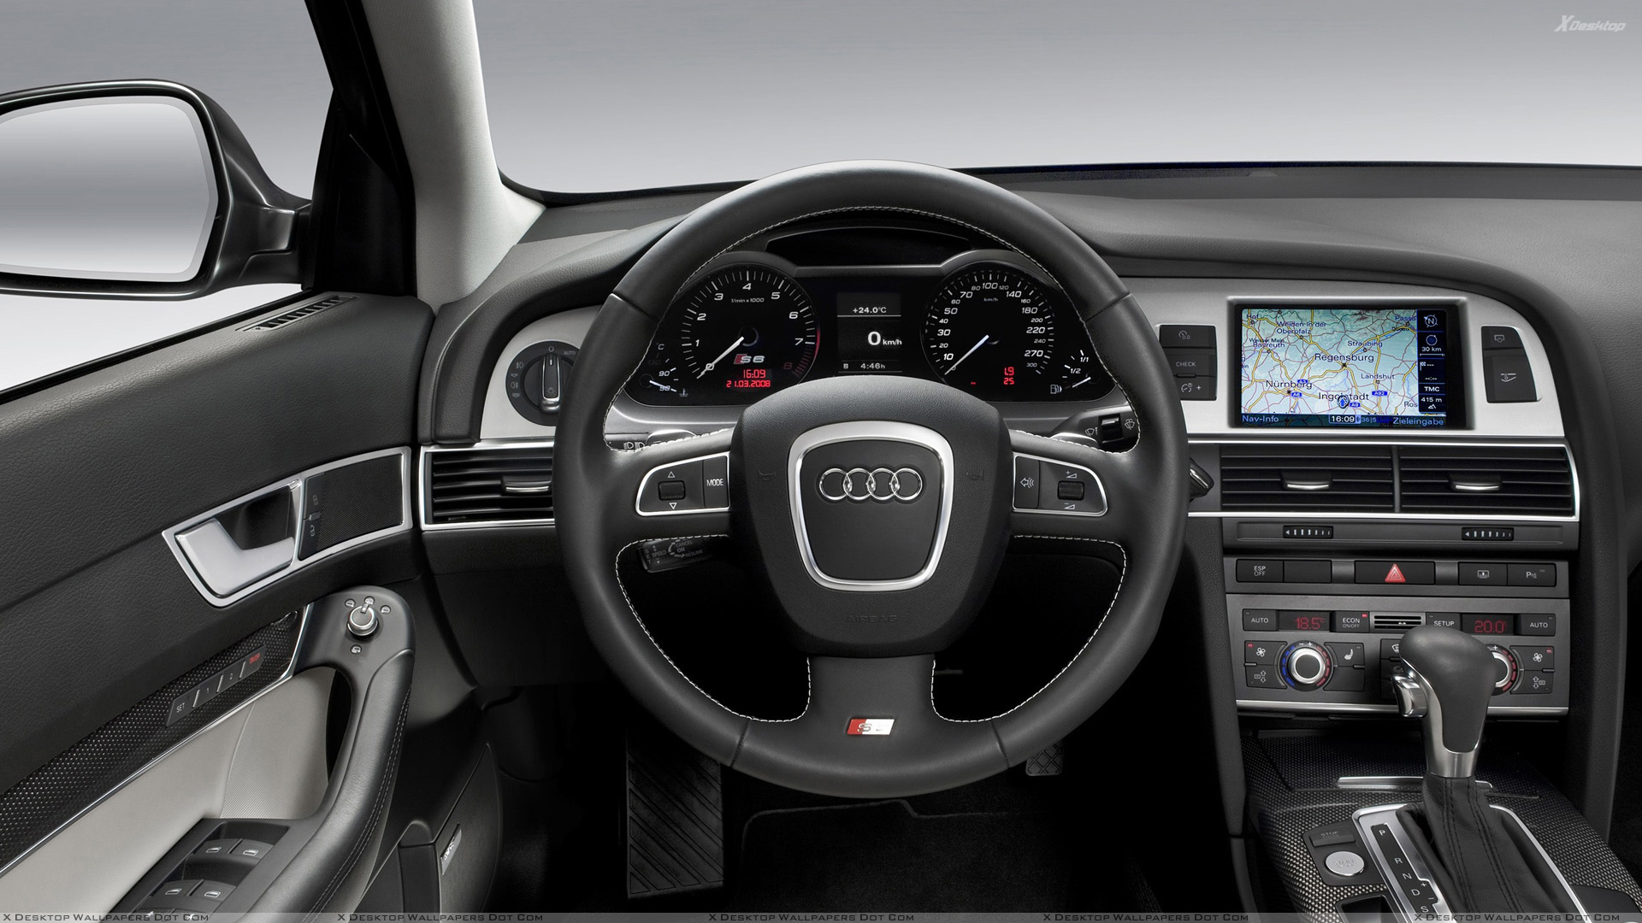

Tangible Abstraction example
Consider an automobile
As a driver, a user of the car, you have certain interactions that take place in order to utilize the car for its intended purpose.
You get in, insert the key, start the car, shift, brake, accelerate, and steer in order to drive.
From an abstraction point of view, we can say that you are seeing the logical perspective of the automobile. You are using the functions provided by the car designers for the purpose of transporting you from one location to another.
These functions are sometimes also referred to as the interface.
On the other hand, the mechanic who must repair your automobile takes a very different point of view.
He not only knows how to drive but must know all of the details necessary to carry out all the functions that we take for granted.
He needs to understand how the engine works, how the transmission shifts gears, how temperature is controlled, and so on.
This is known as the physical perspective, the details that take place “under the hood.”

Slide 11

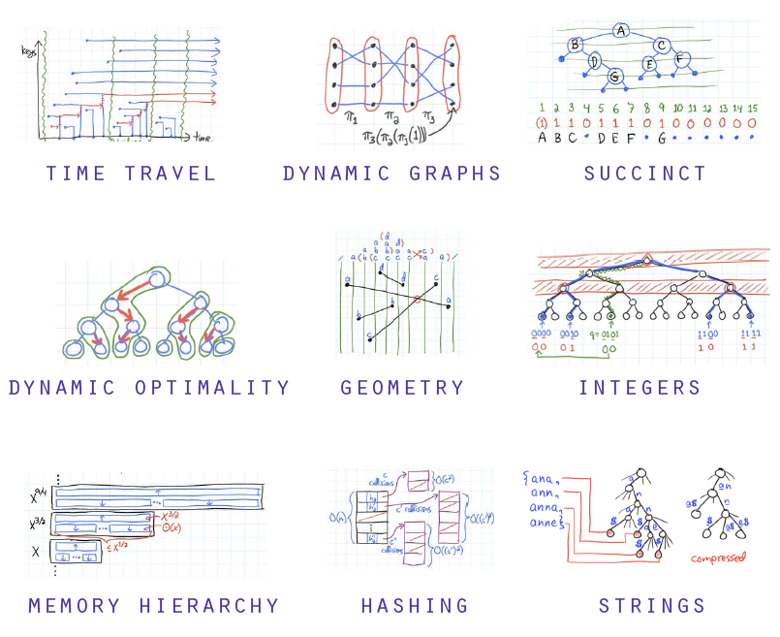
Abstraction example applied to IT
A similar analogy occurs when using computers
Most people use computers to write documents, send and receive email, surf the web, play music, store images, and play games without any knowledge of the details that take place to allow those types of applications to work.
They view computers from a logical or user perspective.
Computer scientists, programmers, technology support staff, and system administrators take a very different view of the computer.
They must know the details of how operating systems work, how network protocols are configured, and how to code various scripts that control function.
They must be able to control the low-level details that a user simply assumes.

Slide 12
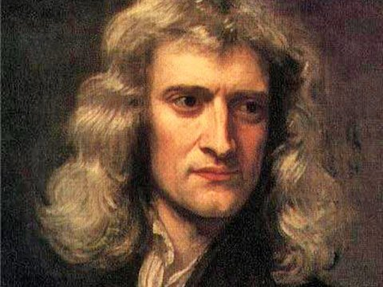
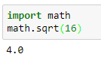
Abstraction hierarchies within computer science
The common point for both of these examples is that the user of the abstraction, sometimes also called the client, does not need to know the details as long as the user is aware of the way the interface works.
This interface is the way we as users communicate with the underlying complexities of the implementation.
Abstractions can be used at different layers of a computing system
Compilers
Programming languages
Functions
Classes
Libraries
Frameworks
…
Consider two alternative ways of computing the square of the number
The Python math module
Newton’s method

Slide 13
The usefulness of abstractions
The difficulty that often arises for software developers is the fact that computational problems and their solutions tend to be complex
Simple, language-provided constructs and data types, although certainly sufficient to represent complex solutions, are typically at a disadvantage as we work through the problem-solving process
We need ways to control this complexity and assist with the creation of solutions
To manage the complexity of problems and the problem-solving process, computer scientists use abstractions to allow them to focus on the “big picture” without getting lost in the details.
By creating models of the problem domain, we are able to utilize a better and more efficient problem-solving process.
2 main types of abstraction in computer science
Procedural abstraction
Data abstraction

Slide 14
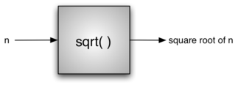
Procedural abstraction
A wrapper/encapsulation around an algorithm
In the example below, we do not necessarily know how the square root is being calculated, but we know what the function is called and how to use it.
If we perform the import correctly, we can assume that the function will provide us with the correct results.
We know that someone implemented a solution to the square root problem but we only need to know how to use it.
This is sometimes referred to as a “black box” view of a process.
We simply describe the interface: the name of the function, what is needed (the parameters), and what will be returned. The details are hidden inside

Slide 15
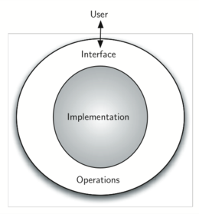
Data abstractions
We referred to procedural abstraction as a process that hides the details of a particular function to allow the user or client to view it at a very high level
A similar idea is a data abstraction
An abstract data type, sometimes abbreviated ADT, is a logical description of how we view the data and the operations that are allowed without regard to how they will be implemented
This means that we are concerned only with what the data is representing and not with how it will eventually be constructed
By providing this level of abstraction, we are creating an encapsulation around the data.
The idea is that by encapsulating the details of the implementation, we are hiding them from the user’s view
This is called information hiding.
This provides an implementation-independent view of the data.
Notes:
The implementation of an abstract data type, often referred to as a data structure, will require that we provide a physical view of the data using some collection of programming constructs and primitive data types
Since there will usually be many different ways to implement an abstract data type, this implementation independence allows the programmer to switch the details of the implementation without changing the way the user of the data interacts with it.
The user is not concerned with the details of the implementation so the user can remain focused on the problem-solving process.

Slide 16
Why study algorithms?
Most classical algorithms are quite general and a need for a certain one can come up many times over the course of a software developer career
If you are stuck on a computational problem, most likely there will be a published algorithm somewhere that could help you
However, if you haven't studied them too much and hence do not know that the particular one you need exists, you are going to waste time figuring out how to handle the situation, and then probably write a sub-optimal solution to the problem as well
It will increase your problem solving and logical skills, therefore meaning that studying them will benefit you even if you never need to implement any algorithm that you read about during your study
If you study and understand why computational problems have been solved in certain ways, then that will have a massively positive effect on how you approach your own computational problems in the future, both in software development and other areas of life
Many software developer job interviews are technical in nature, and so you will likely be questioned on technical issues around algorithms and data structures that are relevant for the job

Slide 17
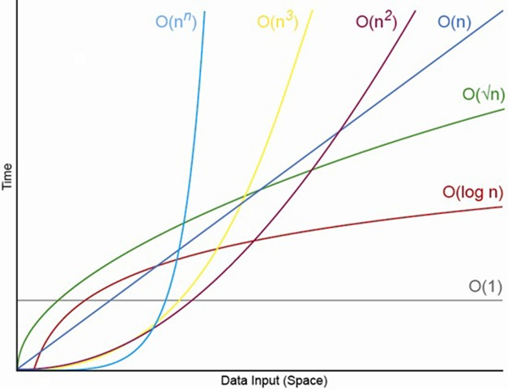
Comparing algorithms
Algorithms are often quite different from one another.
Consider the example of sqrt seen earlier.
It is entirely possible that there are many different ways to implement the details to compute the square root function.
One algorithm may use many fewer resources than another.
For instance, one algorithm might take 10 times as long to return the result as the other.
We would like to have some way to compare these two solutions.
Even though they both work, one is perhaps “better” than the other.
Better often means it takes less CPU or memory resources
As we study algorithms, we can learn analysis techniques that allow us to compare and contrast solutions based solely on their own characteristics, not the characteristics of the program or computer used to implement them.
In the worst case scenario, we may have a problem that is intractable, meaning that there is no algorithm that can solve the problem in a realistic amount of time.
There will often be trade-offs that we will need to identify and decide upon.

Slide 18
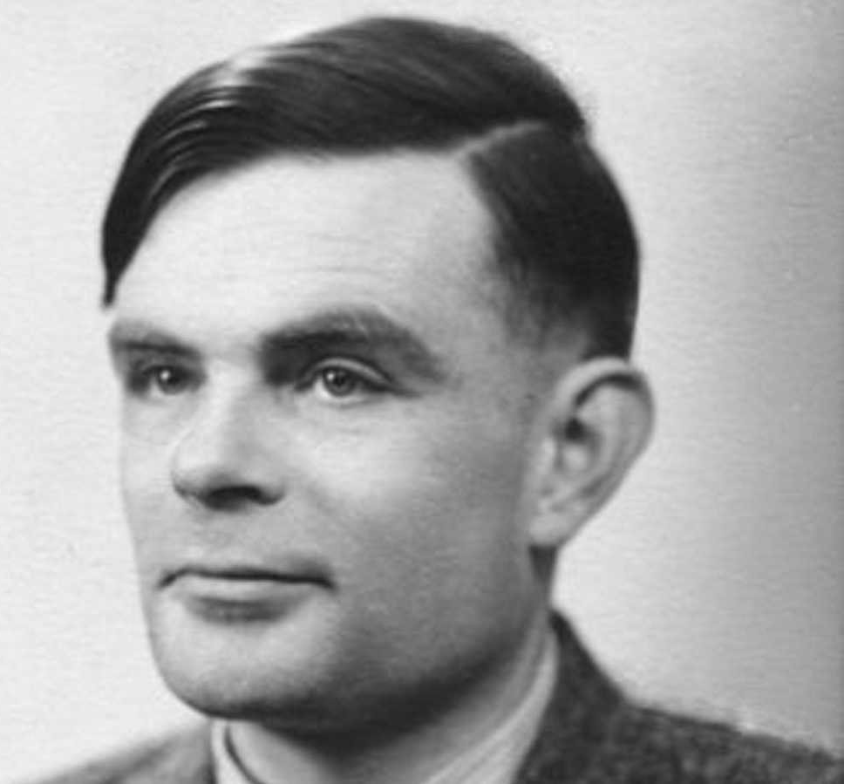
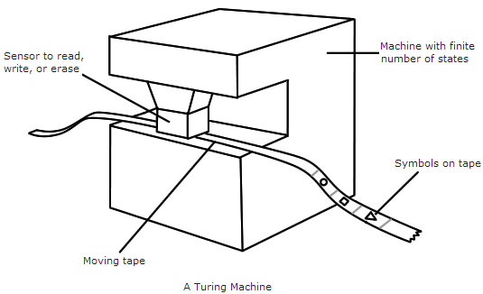
Deterministic versus nondeterministic Turing machines
A deterministic Turing machine is the sort of computer we encounter in everyday life
A non-deterministic Turing machine is a machine that comes with unlimited parallelism
For example, if you come to a fork on a road, you can either take the left road or the right road. That is how a deterministic Turing machine operates
But since non-deterministic Turing machine has unlimited parallelism, it can take both the roads simultaneously
Notes:
A Turing machine is a mathematical model of computation that defines an abstract machine, which manipulates symbols on a strip of tape according to a table of rules. Despite the model's simplicity, given any computer algorithm, a Turing machine capable of simulating that algorithm's logic can be constructed.
The machine operates on an infinite memory tape divided into discrete cells. The machine positions its head over a cell and "reads" (scans) the symbol there. Then, as per the symbol and its present place in a finite table of user-specified instructions, the machine (i) writes a symbol (e.g., a digit or a letter from a finite alphabet) in the cell (some models allowing symbol erasure or no writing),then (ii) either moves the tape one cell left or right (some models allow no motion, some models move the head), then (iii) (as determined by the observed symbol and the machine's place in the table) either proceeds to a subsequent instruction or halts the computation.
The Turing machine was invented in 1936 by Alan Turing, who called it an a-machine (automatic machine). With this model, Turing was able to answer two questions in the negative: (1) Does a machine exist that can determine whether any arbitrary machine on its tape is "circular" (e.g., freezes, or fails to continue its computational task); similarly, (2) does a machine exist that can determine whether any arbitrary machine on its tape ever prints a given symbol. Thus by providing a mathematical description of a very simple device capable of arbitrary computations, he was able to prove properties of computation in general—and in particular, the uncomputability of the Entscheidungsproblem ("decision problem").
Turing machines have practical limitations due to the constraints of mechanical linear computation. While they can express arbitrary computations, their minimalistic design makes them unsuitable for computation in practice: real-world computers are based on modified designs that, unlike Turing machines, use random-access memory.
Turing completeness is the ability for a system of instructions to simulate a Turing machine. A programming language that is Turing complete is theoretically capable of expressing all tasks accomplishable by computers; nearly all programming languages are Turing complete if the limitations of finite memory are ignored.

Slide 19
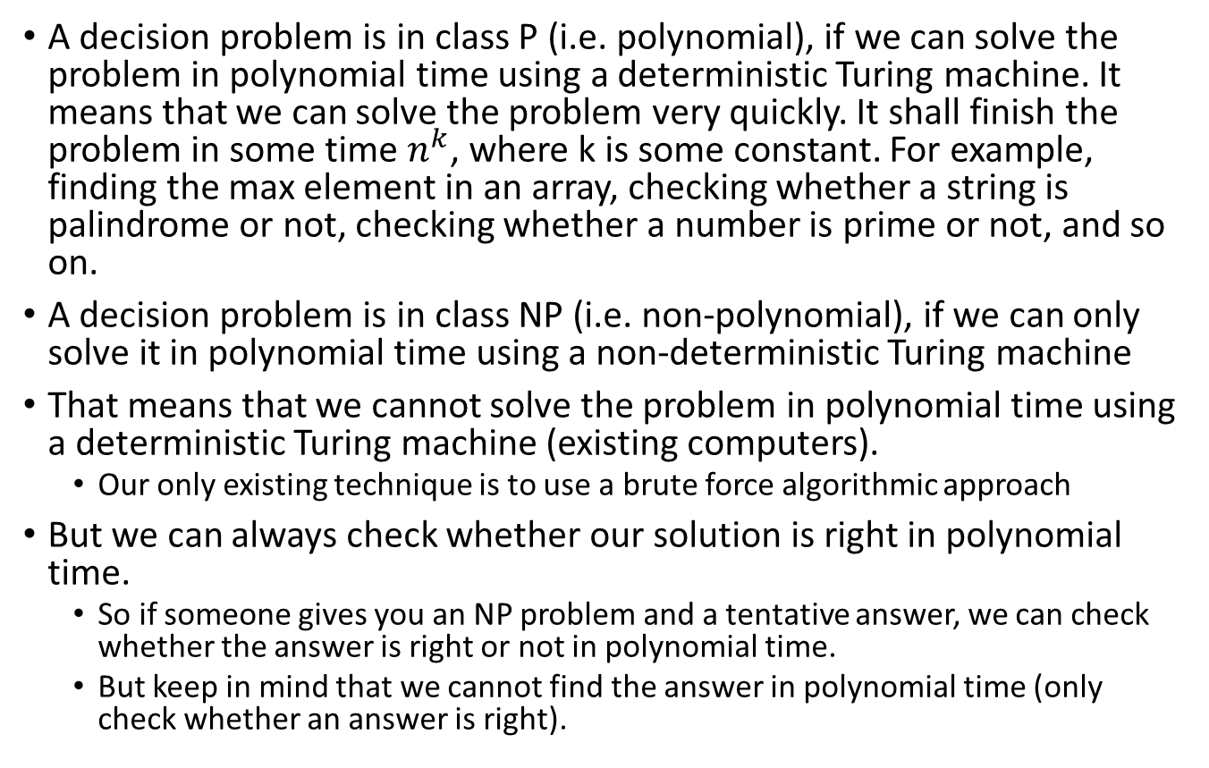
P versus NP problems
A decision problem is in class P (i.e. polynomial), if we can solve the problem in polynomial time using a deterministic Turing machine. It means that we can solve the problem very quickly. It shall finish the problem in some time $n^{k}$, where k is some constant. For example, finding the max element in an array, checking whether a string is palindrome or not, checking whether a number is prime or not, and so on.
A decision problem is in class NP (i.e. non-polynomial), if we can only solve it in polynomial time using a non-deterministic Turing machine
That means that we cannot solve the problem in polynomial time using a deterministic Turing machine (existing computers).
Our only existing technique is to use a brute force algorithmic approach
But we can always check whether our solution is right in polynomial time.
So if someone gives you an NP problem and a tentative answer, we can check whether the answer is right or not in polynomial time.
But keep in mind that we cannot find the answer in polynomial time (only check whether an answer is right).

Slide 20
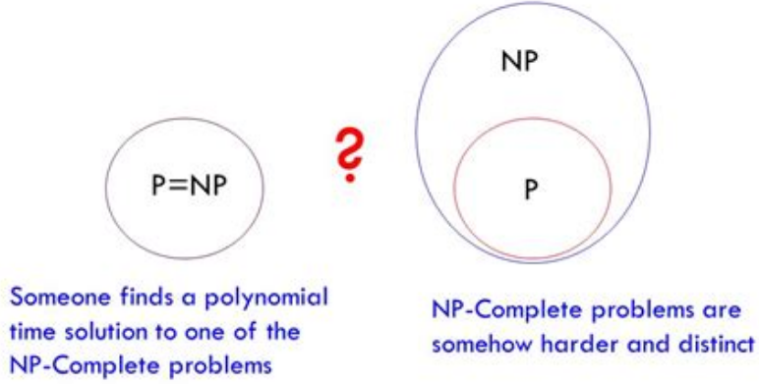
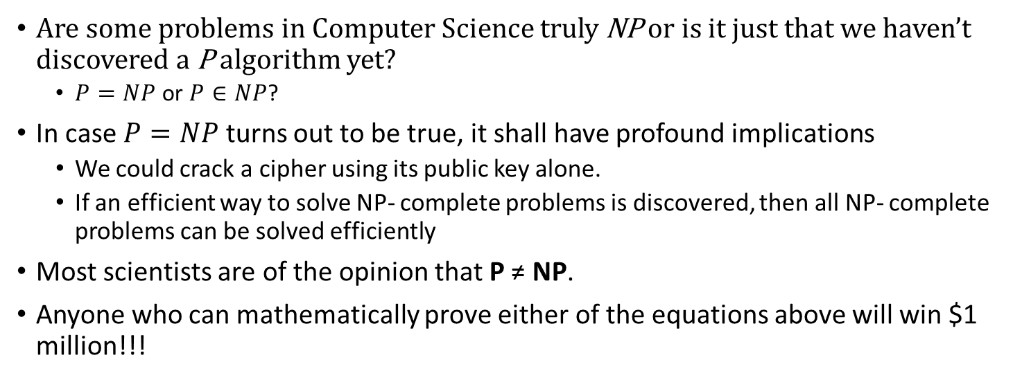
The big question in Computer Science
Are some problems in Computer Science truly NP or is it just that we haven’t discovered a P algorithm yet?
$P=NP$ or $P∈NP$?
In case $P=NP$ turns out to be true, it shall have profound implications
We could crack a cipher using its public key alone.
If an efficient way to solve NP- complete problems is discovered, then all NP- complete problems can be solved efficiently
Most scientists are of the opinion that P ≠ NP.
Anyone who can mathematically prove either of the equations above will win $1 million!!!
?

Slide 21
P versus NP problems example
Q1: 7 x 17 = p
The answer is 119. Easy to solve right? What if I reverse the question?:
Q2: p x q = 119 (what are p & q provided they cannot be 1 & 119)
To solve Q2, assuming that you haven’t seen Q1, you probably have to go through all possible numbers from 2 to 118.
We are yet to discover an efficient algorithm that can find the factors of a number easily. What if I ask you: Could p possibly be 7? You can easily verify the answer right? Just divide 119 by 7!
Multiplication is easy. Finding the original factors of a number is hard.
So Q1 is a P (polynomial) problem because it is easy to solve.
Computer can easily multiply 2 super large numbers without spending significantly more computer time than small numbers.
Q2 is an NP (nondeterministic polynomial) problem because it is easy to verify, but hard to solve.
Finding the factors of a small number such as 119 is still fairly fast for computer to solve, but how about a 500-digit number? It’s impossible for any computer right now.
Notes:
Here’s the important part: Are NP problems (e.g., factorization) also P problems (e.g., multiplication), just that we haven’t discover the efficient way to solve NP problems? Are NP problems really hard to solve, or we just need an “aha moment” from a brilliant scientist to come out with an efficient algorithm?
Or maybe humans are just too dumb? Imagine there would exist machines or life forms that possesses much higher intelligence than human. They see us like how we see ants. Our level of intelligence is insignificant to them. Solving P vs NP problem for them could be like solving 1 + 1 for us!
So why is P vs NP problem important? If we are able to prove P=NP, that means all NP problems can be solved easily within reasonable computer time. We would be able to cure cancer (through efficient molecular simulations which are currently computationally unfeasible), break passwords, etc.
It would be world-changing, bigger than the Internet or the invention of the nuclear bomb.

Slide 22
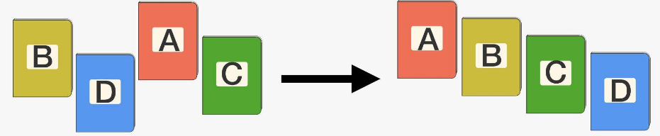
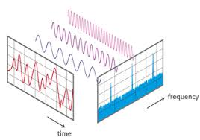
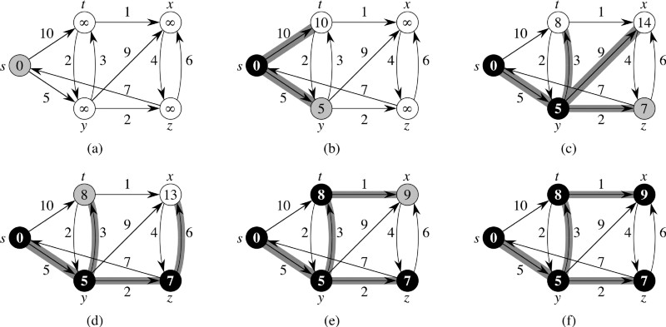
Some important algorithms and their applications
Merge sort, quick sort and heap sort: information retrieval, simulations, search, databases
The fast Fourier transform: Wi-Fi, satellite communication, information compression, medical imaging (MRI, fNIR,…), cochlear implants, BCI, speech recognition,…
Dijkstra’s algorithm: network routing, any shortest path between nodes in a graph type of problem

Slide 23
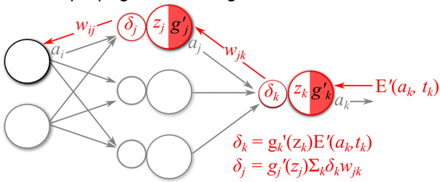
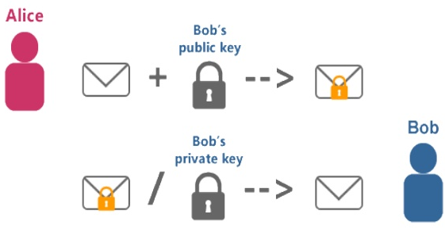
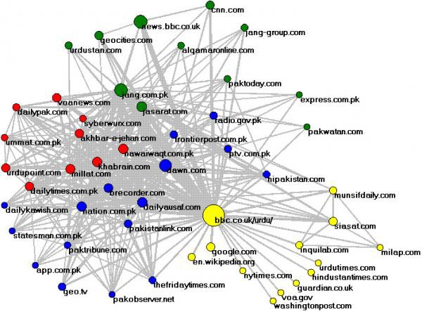
Some important algorithms and their applications
Back propagation algorithm: learning algorithms, artificial intelligence
RSA algorithm: cryptography and cybersecurity (sharing public keys between independent platforms)
Hash functions: cryptography
SVD Dimensionality reduction and recommendation systems: Google in its Page Rank, Facebook when it shows you your news feed, Google+ and Facebook friend suggestion, LinkedIn suggestions for jobs and contacts, Netflix and Hulu for movies, YouTube for videos, etc.

Slide 24
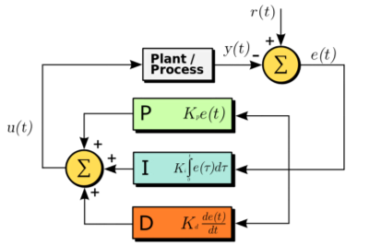
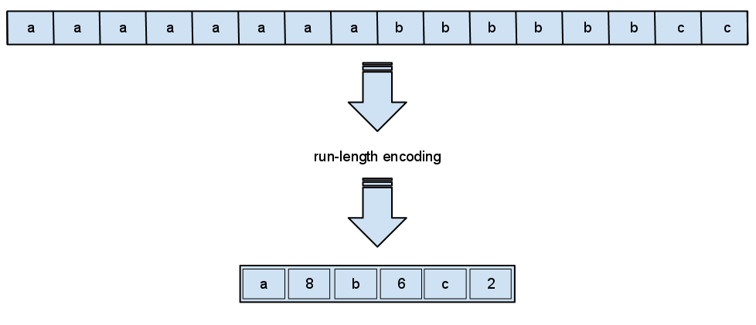

Some important algorithms and their applications
Proportional Integral Derivative Algorithm: machine control applications for satellites, airplanes, cell phone network, robots
Data compression: Digital audio and video, information storage
Random number generation: cryptography, secure Hash algorithms, video games, artificial intelligence, optimization, simulation
Genetic algorithms: optimization for complex parameter landscapes (a new jet engine, algorithmic trading, etc)
Notes:
Proportional Integral Derivative Algorithm: this algorithm uses a control loop feedback mechanism to minimize the error between the desired output signal and the real output signal. It is used wherever you need signal processing or you need an electronic system controlling a mechanical, hydraulic or thermal system using automation.
Today we don’t have a “true” random number generator, but we have some pseudo random number generators that are sufficient.

Slide 25
Take home message
The topic of Algorithms and Data Structures is an important area of knowledge for professional software developers
Computer science uses abstraction as a tool for representing both processes and data
Abstraction allows programmers to manage the complexity of a problem domain by hiding the details of the data and the implementation
Algorithms and data structures are closely related to each other. Algorithms deal with the mechanical steps of solving a problem.
Data structures deal with how to organize the data used by an algorithm so as to meet the complexity bounds of that algorithm

Slide 26
References
Problem-solving with algorithms and data structures

Slide 28
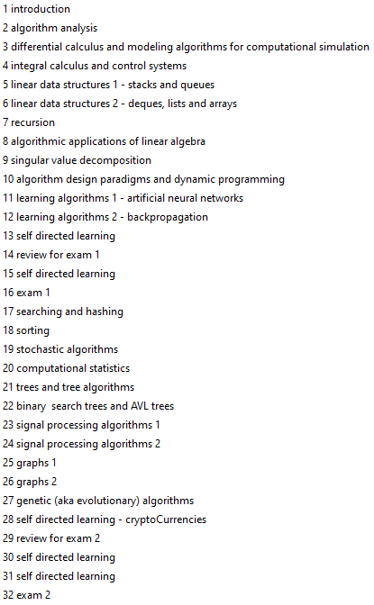
Structure of this paper
This paper contains 3 threads
Classic theoretical algorithms and data structures
Mathematical underpinnings of algorithmic design
Applications of popular algorithms to specific problems

Slide 29
Classroom location and times
BITY3 Stream A IN711 - Algorithms and Data Structures
Monday: 15:00-17:00 in D105B
Thursday: 15:00-17:00 in D105B

Slide 30
Microsoft Teams Channel
Please, add yourselves to the course channel in the BIT all Team:
IN711 - Advanced Algorithms
Place for student to ask questions and for the instructor to make announcements related to the course
Course content will also be uploaded to IN711 - Advanced Algorithms channel
Make sure you check this channel regularly since it will be an official form of communication for the paper
If you do not join the channel, you will miss important announcements and miss access to classroom content
Please use common sense when asking questions
I cannot solve assignment tasks for you
I should not have to repeat information contained in assignments handouts

Slide 31
Grading
Assessment Activity | Weighting
Assignment 1 | 25%
Exam 1 | 25%
Assignment 2 | 25%
Exam 2 | 25%

Slide 32

Final remarks
Good luck with the course
I hope you find it useful
I'll do my best trying to be a good instructor
No matter how good I do my job, you still play the central role in the learning process
I hope that you put a fair amount of effort into the course
Previous experience suggests that showing up to class and being engaged in practicals/labs will be an important predictor of course success

Slide 33
Today’s Practical
Familiarization with Python
Important if you are not confident in Python
Familiarization with Python Jupyter notebooks

